Slide 1
Fast & Reliable Custom Anonymity Network
CS558L – Project Demo
Team 1

Slide 2












Introduction (Thanksgiving theme)
Where did this box
come from ???
What is there inside
the box ???
?
?
?
Decrypting
?
?
Encrypting
?

Slide 3
Three Problems
Fast
Reliable
Anonymous

Slide 4
OSI is heavy…
Payload
54 Bytes, Network Stack
13 Bytes, kernel bypass
TCP Header
(20 Bytes)
No OSI
Team 1 Header
IP Header
(20 Bytes)
Ethernet Header
(14 Bytes)
Notes:
OSI is heavy, because it is designed to serve universal purposes. If one wants to send a packet reliably, one need
an ethernet header; an IP header; a TCP header
In front of the payload.
That is a total of 54 bytes and creates a large overhead especially when transferring small packets
To avoid the overhead problem, we developed our own routing protocol, which only needs 13 bytes, and is fully functioning with small-mid scaled network. So… no osi!

Slide 5
To route a packet reliably…
0
15
31
1. Machine
Source Addr.
Dest. Addr.
Protocol
Size
Port
2. Program
Sequence
Info
3. Program Instance
Payload
Notes:
Here is our logic: to route a packet and send it to the destination, we need only three things:
An identifier of the machine(we have destination address)
an identifier of the target program (we have protocol)
and finally, an identifier of the program instance (we have port number) Then we added other necessary information: source address, packet size, sequence number, protocol information, and that’s it.

Slide 6
To route a packet reliably…
Source Addr.
Dest. Addr.
Routing
Protocol
Size
Port
Sequence
Reliable Transfer
Info
Payload
Notes:
If we group these fields, The first four fields are for routing, and the sequence number and protocol info fields will guarantee reliability.

Slide 7
Three Problems
Fast
Reliable
Anonymous

Slide 8
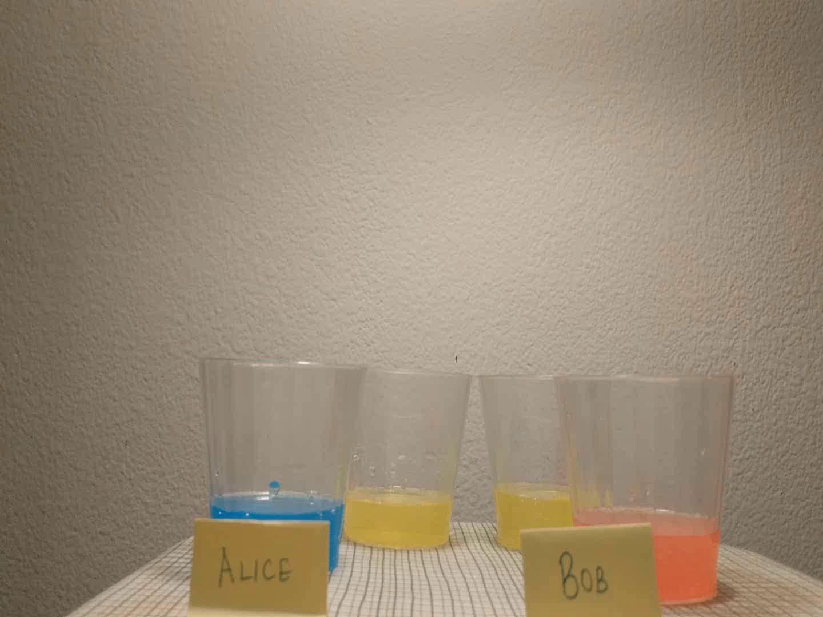

Slide 9
Three Problems
Fast
Reliable
Anonymous

Slide 10
Router Design
Routing Table
Classify
Encrypt
Decrypt
Fetch Handler
User Land
Kernel Network Stack
Sniff Handler:
Kernel Bypassing
Inject Handler:
Kernel Bypassing
Network Interface
Packet
Packet
Router

Slide 11


Sender and Receiver
3
2
2
3
1
2
2
101
3
3
1
1
2
2
2
101
1
101
Link 1
Link 2
Sender
Router
Receiver
99% Reduction
209715
NAK
Packets
147
NAK
Packets

Slide 12

Full Duplex Transfer
Node2
Node2
12
3
3
2
3
2
3
3
2
2
Node1
Node3
12
Node3
13
13
Node3
13
Node2
Node3
23
23
File1
File2

Slide 13




Network Topology
RECEIVER
RECEIVER
Happy Diwali
Happy thanksgiving
LAN1
SENDER
Happy Diwali
Happy thanksgiving
SENDER
LAN3
LAN2
Notes:
With First Click Network Starts building itself and with second click Key exchange and third click simultaneous packet transfer happens.

Slide 14
Dynamic Routing
Normal Routing
Routing Info Timeout == 1
0
15
31
Source Addr.
Dest. Addr.
Protocol
Size
Port
Send Routing Info Query
Sequence
Calc Cost
and Update
Info
Payload
Wait Query Reply
Query Reply Timeout == 1

Slide 15




How Dynamic Routing works ?
DEST. | COST
E | 1
DEST. | COST
E | 1
A | 3
DEST. | COST
E | 1
A | 2
Cost=1
A
Cost=1
DEST. | COST
A | 1
DEST. | COST
A | 1
E | 3
DEST. | COST
A | 1
E | 2
Cost=1
Cost=1
Cost=1
E
DEST. | COST
A | 2
E | 2
DEST. | COST

Slide 16
Need fast packet sniffing…
Kernel Network Stack?
Rejected
System Call
Large Header
Layers
User Land
Network Interface

Slide 17
Need fast packet sniffing…
RAW Socket with
PF_PACKET
Rejected
User Land
Network Interface
System Call
Limited Buffer
Notes:
Citation: https://www.kernel.org/doc/Documentation/networking/packet_mmap.txt

Slide 18
Need fast packet sniffing…
Raw Socket with PF_RING
PCAP
Approved
MMAP to user space
No System Call
Configurable ring buffer
User Land
Network Interface
Notes:
Citation: https://www.kernel.org/doc/Documentation/networking/packet_mmap.txt

Slide 19
PCAP
Packet Size (Bytes) | Raw Socket with PF_PACKET (Mbps) | PCAP (Mbps) | Improvement (%)
64 | 6.81 | 7.97 | 17.03
128 | 95.95 | 99.30 | 3.49
256 | 173.68 | 274.10 | 57.82
512 | 327.57 | 393.53 | 20.14
1024 | 483.48 | 576.25 | 19.19
1514 | 885.65 | 984.43 | 11.15
954 Mbps
Notes:
Citation: http://www.embedded.com/print/4008809

Slide 20
Things changed with anonymity…
Theoretical Max Throughput: 208 Mbps

Slide 21
Encryption and Decryption are SLOW,
But...
Computation Intense
Memory Locality
No Data Dependency
Parallelism

Slide 22
OpenMP…
High Level API with Compiler Directives
Thread Based & Shared Memory
Parallelism with hardware support

Slide 23
Leave more space for retransmission
Massive loops while checking missing packets
Branches in classifying packets
Inefficient Codes
…
Add Compiler Flags
Unroll Loops to save CPU and Memory cycles
Reorder instructions to speed up branches
Advanced CPU instruction
Short Function Inlining
Stack Optimization
…
Notes:
Citation: https://gcc.gnu.org/onlinedocs/gcc/Optimize-Options.html

Slide 24
Optimization
~ 88% Improvement
~ 82%
Max Value
Theoretical Max Throughput: 392.5 Mbps
Throughput Reached:
~ 320 Mbps
Theoretical Max Throughput: 208 Mbps

Slide 25


